Slide 1
OGF NSI Protocol
Web Services as a transport layer for NSI
John MacAuley
SURFnet bv.
john@surfnet.nl

Slide 2


The SOAP Stack
NSI Protocol
XML
SOAP
HTTP
TLS
TCP/IP

Slide 3
Providers and Requestors
Provider Entity
  A web service is provided by a “provider entity” and exposed through a Service Endpoint Interface (SEI).
  A provider entity publishes its service through a WSDL document-based description, and provides a Service Endpoint Reference (EPR).
Requestor Entity
  A web service is used by a “requestor entity.”
  A requestor entity uses the web service’s WSDL document–based description and EPR to interact with the web service.
Consumes
Requestor
Entity
Interact
WSDL
SEI
Provider
Entity
Publishes

Slide 4
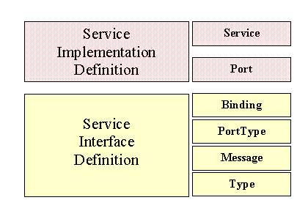
Service Description
A provider entity formally describes a web service through a WSDL 1.1 document
  Specifies the service interface (messages, operations, types).
  Includes the endpoint HTTP URI address of the provider agent.
A WSDL document is only a syntactic description of the service, and is void of interface semantics.

Slide 5
Service Semantics
Service semantics are defined either implicitly or explicitly through a verbal or written exchange between a provider entity and a requestor entity.
The NSI Web Services Protocol description will require a dedicated document to describe service semantics.

Slide 6
Basic Request/Response
Web services support both a basic request/response messaging model using the HTTP/SOAP binding:
  HTTP POST carries the request operation.
  HTTP response to POST carries result of the operation.
  HTTP socket blocks until result it returned (synchronous).
  Standard design pattern utilizes multiple threads to issue concurrent operations.
HTTP POST (SOAP Request)
Requestor
Entity
Provider
Entity
200 OK (SOAP Response)

Slide 7
Operation definition
We can define a simple “reservation” WSDL operation following the request/response pattern:
  <wsdl:operation name="reserve">
  <wsdl:input message=“reserveRequest” />
  <wsdl:output message=“reserveConfirmed” />
  <wsdl:fault name="ServiceException” message="ServiceException” />
  <wsdl:fault name="PolicyException” message="PolicyException” />
  <wsdl:fault name=”AuthException” message=”AuthException” />
  </wsdl:operation>

Slide 8
Events/Notifications
There are two primary notification patterns used for SOAP
  Notification “push” interface that delivers events asynchronously to a client’s registered SOAP endpoint.
  Notification “pull” interface that will queue notifications for the client to poll via the publisher’s SOAP endpoint.
There are two options for notification service definitions
  Application specific notification operations defined through application specific WSDL allowing for custom notification solutions
    3GPP Parlay X standards follow this model having integrated notifications into their messaging definitions.
  Standards based notification frameworks (WS-BaseNotification/WS-Eventing) following the publish/subscribe pattern with topics
    Subscribe, Renew, Unsubscribe, PauseSubscription, ResumeSubscription, Notify, GetCurrentMessage, GetMessages.

Slide 9
Notification Support
Push-based notifications require both subscribing and publishing entities to maintain SOAP endpoints:
HTTP POST (Subscribe)
Subscriber
Entity
Publisher
Entity
200 OK (SubscribeResponse)
.
.
.
HTTP POST (Notification)
Subscriber
Entity
Publisher
Entity
200 OK

Slide 10
Asynchronous Messaging
NSI protocol requires response (confirmed) messages to be delivered to a RA at an arbitrary point in the future
  This requirement leads us towards an asynchronous messaging architecture where we decouple response delivery from the request.
  Basic HTTP/SOAP binding uses a synchronous request/response model.
WS-Addressing was introduced to decouple SOAP message routing from the underlying transport
  Both synchronous and asynchronous models supported.
  Supports independent SOAP endpoints for response and fault delivery per request message.

Slide 11
WS-Addressing header
WS-Addressing utilizes the SOAP header to convey both routing information to the target service, and routing information for the response.
<S:Header>
<wsa:Action>http://www.ogf.org/nsi/ConnectionService/reserve</wsa:Action>
<wsa:MessageID>uuid:aaaabbbb-cccc-dddd-eeee-ffffffffffff</wsa:MessageID>
<wsa:From>
<wsa:Address>http://dracproxy01.surfnet.nl/nsi/connection</wsa:Address>
</wsa:From>
<wsa:To S:mustUnderstand="1">
http://oscars.es.net/nsi/connection
</wsa:To>
<wsa:ReplyTo>
<wsa:Address>http://dracproxy01.surfnet.nl/nsi/connection</wsa:Address>
</wsa:ReplyTo>
<wsa:FaultTo>
<wsa:Address>http://dracproxy01.surfnet.nl/nsi/connection</wsa:Address>
</wsa:FaultTo>
</S:Header>

Slide 12
WS-Addressing support
Asynchronous WS-Addressing require both requestor and provider entities to maintain SOAP endpoints:
HTTP POST (reserve)
Requestor
Entity
Provider
Entity
A
202 Accepted
.
.
.
HTTP POST (reserveConfirmed)
Requestor
Entity
Provider
Entity
B
200 OK

Slide 13
NSI messaging patterns
Use Request, ACK, Confirm pattern
  Keep it simple - follow the WS-Addressing messaging patterns but simplify for NSI specific requirements.
  Use basic point-to-point HTTP exchanges.
  Reduce usage of additional SOAP framework capabilities needed by WS-Addressing.
  Specify single HTTP/SOAP profile for NSA interoperability.

Slide 14
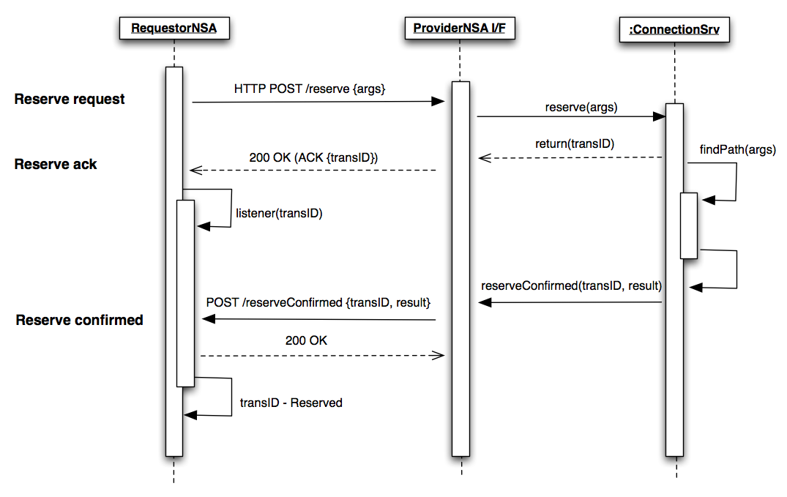
NSI messaging pattern

Slide 15
Web Service message content
SOAP
  All Web Service messages SHALL send and accept messages that conform to the SOAP use defined in the WS-I Basic Profile [1], using the document/literal encoding style.
XML
  All Web Service messages SHALL send and accept messages that conform to the XML use defined in the WS-I Basic Profile [1].
HTTP
  All Web Service messages SHALL send and accept messages that conform to the HTTP use defined in the WS-I Basic Profile [1].
[1] WS-I Basic Profile Version 1.0
  http://www.ws-i.org/Profiles/BasicProfile-1.0-2004-04-16.html

Slide 16
Web Service interface definitions
WSDL
  All Web Service interfaces SHALL be defined using WSDL 1.1 as defined in the WSDL specification [2] and be conformant to the WSDL use defined in WS-I Basic Profile [1].
[1] WS-I Basic Profile Version 1.0
  http://www.ws-i.org/Profiles/BasicProfile-1.0-2004-04-16.html
[2] W3C Note (15 March 2001): "Web Services Description Language (WSDL) 1.1".
  http://www.w3.org/TR/2001/NOTE-wsdl-20010315

Slide 17
NSI transport mechanism
HTTPS (HTTP over TLS) will be the primary message transport mechanism providing encryption, data integrity, and certificate-based authentication.
Stream-based transport will provide data segmentation at the lower layers of the TCP/IP stack.
HTTPS can be used for transferring large datasets through its chunk support.
Do we need a separate paging mechanism for NSI responses?

Slide 18
Security for NSI Web Services
Peer NSA endpoint authentication MUST use bilateral connection mode TLS handshaking so any connection can be mutually authenticated. This will require public certificates for trusted NSA to be made available on peer NSA servers. How access to these certificates is provided can be consider out of scope of this specification.
If a message contains an identifier and/or credentials representing the sender of the message then these SHALL be provided in a manner prescribed by WS-Security [3].
Encryption of message content is required by the NSI Web Service Provider and MUST be accomplished through use of Transport Layer Security using HTTP over TLS as specified in the WS-I Basic Profile [1].
Integrity of the message content MAY be required by the Web Service Provider. If this is required, then this SHALL be accomplished using XML Digital Signature [4].
[1] WS-I Basic Profile Version 1.0
  http://www.ws-i.org/Profiles/BasicProfile-1.0-2004-04-16.html
[3] OASIS Standard 200401 (March 2004): "Web Services Security: SOAP Message Security 1.0 (WS-Security 2004)".
  http://docs.oasis-open.org/wss/2004/01/oasis-200401-wss-soap-message-security-1.0.pdf.
[4] W3C Recommendation (12 February 2002): "XML-Signature Syntax and Processing”.
  http://www.w3.org/TR/2002/REC-xmldsig-core-20020212/

Slide 19
XML Data types
Where possible standard XML Schema data types are used, as defined in section 3 (Built-in datatypes) in XML Schema [5].
[5] W3C Recommendation (2 May 2001): "XML Schema Part 2: Datatypes".
  http://www.w3.org/TR/2001/REC-xmlschema-2-20010502/

Slide 20
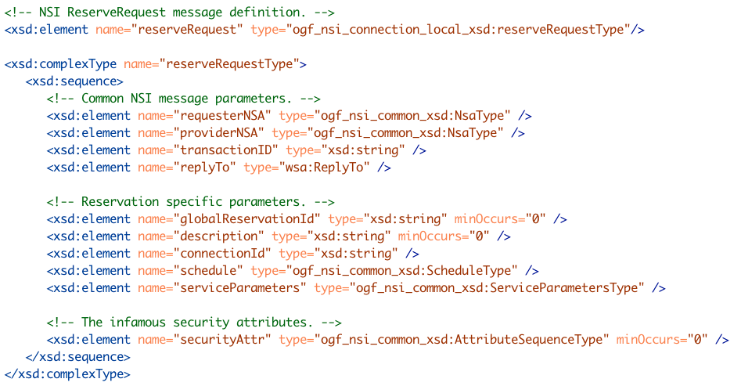
Reserve Request

Slide 21


